Slide 1
Content Objective: Students will analyse various methods of AI data reasoning to determine flaws in the system.
Wednesday June 19th
Recap Yesterday
Data Representation / Pattern Recognition
Eleanor Haberl’s Short Story “Imperfect Match”
Homework
No homework in the course. But I will make you think!

Slide 2


What is Artificial Intelligence actually? Is it something to be afraid of? Remember the medical data collector IBM Watson...
Remember the “smart” piece of paper...is a fancy computer any different?

Slide 3
Computer Vision
On a piece of paper draw what a computer might see when it looks at the image below...
What is it called when a computer notices a large difference between one color and another?

Slide 4
Qualitative Data vs Quantitative Data
A hot room vs a cool room
Hard Exam vs Easy Exam
A full cup vs an empty cup
A loud party vs a quiet party
102 F vs 24 F
64% vs 97%
12 litres vs 0 litres
40 decibels vs 80 decibels

Slide 5

Data Representation
How can we identify people in this room in unique ways by asking specific questions? How could a computer sort through us to isolate unique people?
In other words we want qualitative data that can help separate us by certain non-numerical characteristics.

Slide 6

Data Representation / Pattern Recognition
Let’s play an old school game that has been around since the 1800’s...

Slide 7
Decision Tree
Why would I make us do this activity when we are talking about computers / AI?

Slide 8
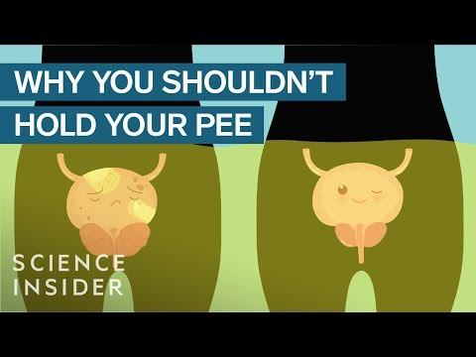
Bathroom Break

Slide 9
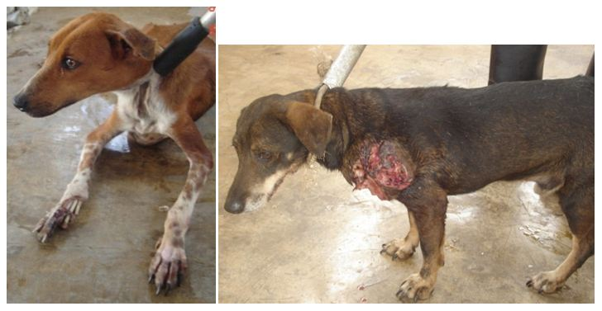

Pattern Recognition
Eleanor Haberl’s “Imperfect Match”
The Story of Tater Tot
Which of these dogs would you want to take home with you? Why?
vs.

Slide 10

Pattern Recognition
Questions 3 and 4 on the discussion guide portion of the story ask about your pet preference, ethnicity, and family size.
Let’s collect the data of our classroom and see if we can determine any patterns. Do these patterns have significance or not?
The last question asks about how we can improve the AI system in this story. What are some of your thoughts?

Slide 11
Data Representation / Reasoning - Ethical Dilemmas
Choose a topic to research...
Just like before we will make little posters and you will “teach” these subjects to the class…(groups that did not go last time will go this time)
Uygur Muslim Humanitarian Crisis in China
Autonomous Weapons
China’s “Social Credit” System (Coming to America?)
Deep Fakes / New Age Propaganda

